Slide 1
CYBERSECURITY AWARENESS
Instructor
Dr Tania Islam
Assistant Professor
Department of Computer Science And Engineering
University of Barishal
Presented by
Sourav Das Batch 066;
Computer Fundamental And Office Application Course

Slide 2
CONTENTS OF THIS TEMPLATE
Objectives
Data Representation
Comparison on Issues(Two Factor Authentication, Cyber Awareness, Concern Level etc)
Database
QnA Session

Slide 3
TABLE OF CONTENTS
01
02
CYBER AWARENESS
CYBER SAFETY
03
04
STEPS TO PREVENT
TWO FACTOR AUTHENTICATION

Slide 4
“There’s no silver bullet solution with cyber security a layered defense is the only viable defense”
—James Scott

Slide 5
“It takes 20 years to build a reputation and a few minutes of cyber-incident to ruin it.”
—Stephane Nappo

Slide 6
01
CYBER AWARENESS
Cybersecurity Awareness is essential in protecting sensitive information from evolving threats such as phishing, malware, social engineering, and insider attacks. Cybercriminals exploit human errors and technical vulnerabilities to gain unauthorized access to systems, steal data, or disrupt operations.

Slide 7
01
PROBLEM VS. SOLUTION
Here you could describe the topic of the section

Slide 8

IMPORTANCE
In the digital age, where technology plays a central role in everyday operations, the importance of cyber security awareness cannot be overstated. With cyber threats becoming increasingly sophisticated, organizations need to arm their employees with the knowledge and skills to detect and prevent potential attacks.

Slide 9
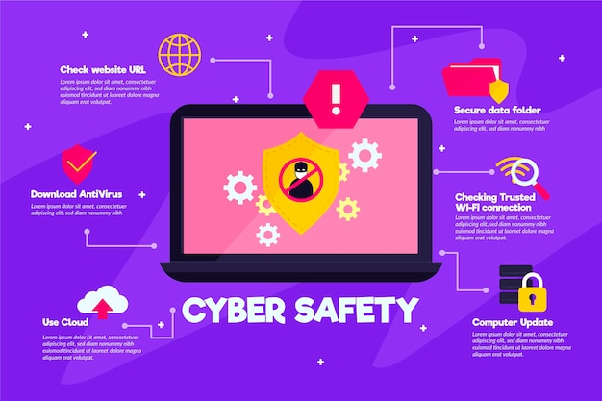
TO BE FOLLOWED

Slide 11
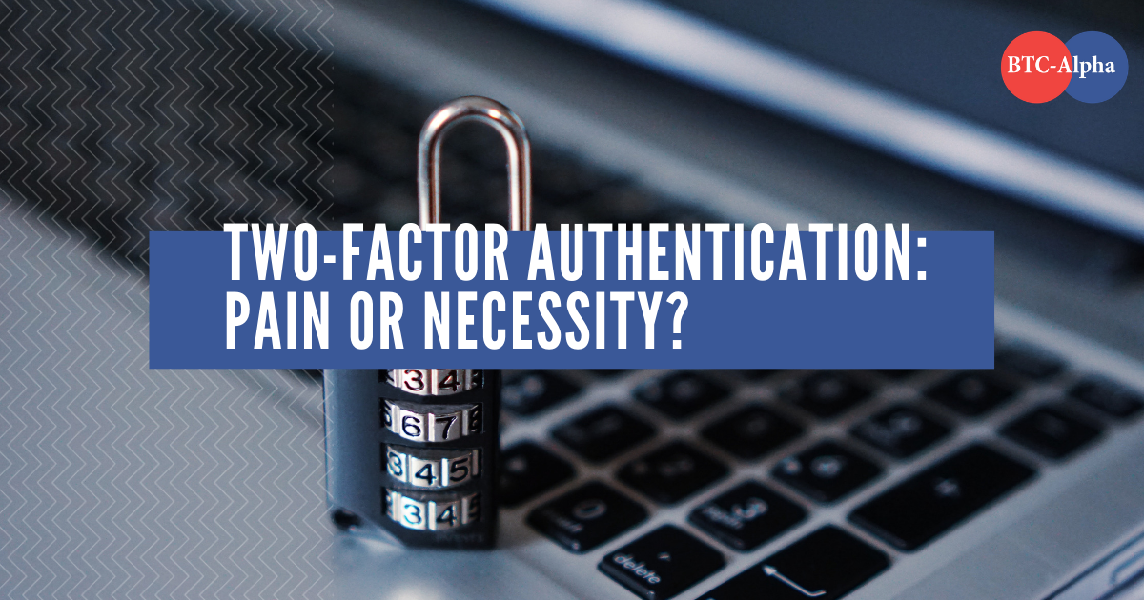
2FA (Two Factor Authentication)
Two-factor authentication (2FA) is necessary because it adds an extra layer of security to online accounts by requiring users to provide not only their password but also a second form of identification, like a code sent to their phone, to access sensitive information, significantly reducing the risk of unauthorized access even if their password is compromised; making it crucial for protecting sensitive data like financial information, personal details, and business accounts.

Slide 12
What does cybersecurity awareness include?
Recognizing phishing attempts
Using strong passwords
Practicing safe online habits
Being aware of social engineering attacks
Reporting suspicious activity
Enabling multifactor authentication (MFA)

Slide 13
Thank You

